Slide 1

LOGIC Circuits

Slide 2

HAPPY NEW YEAR!

Slide 3
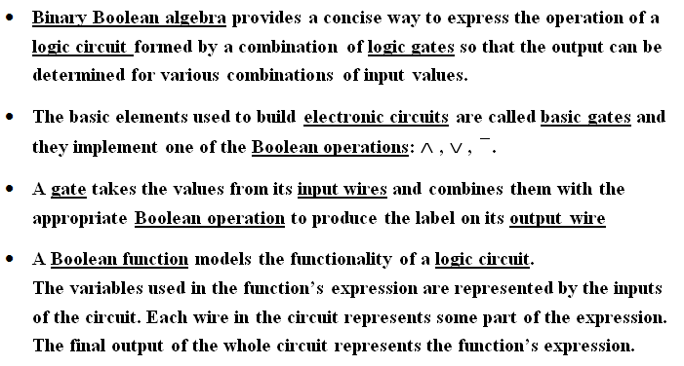
Logic Circuits

Slide 4
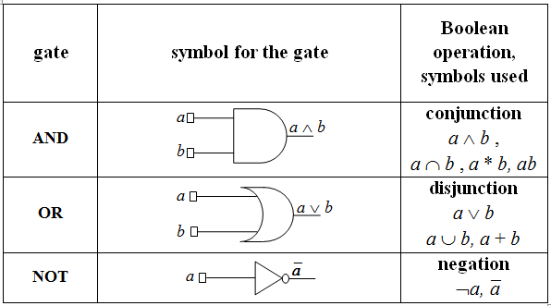
Basic gates – IEEE standards

Slide 5
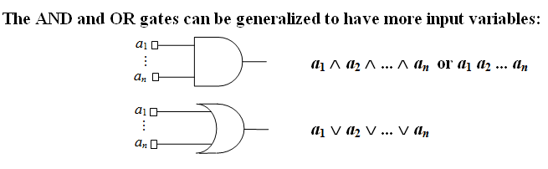
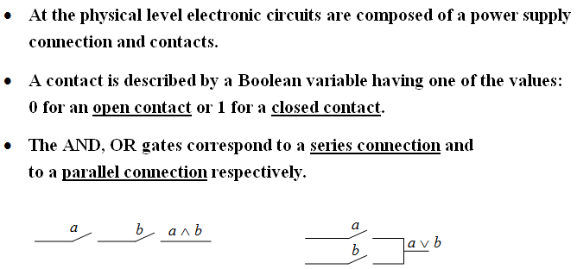

Slide 6
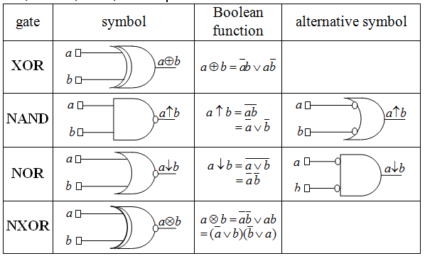
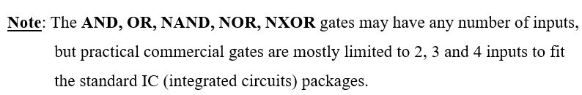
Derived gates: XOR, NAND, NOR, NXOR

Slide 7
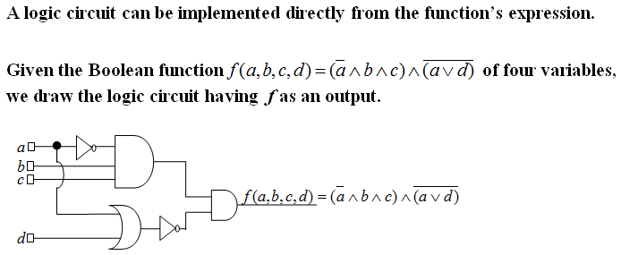
Example 1

Slide 8
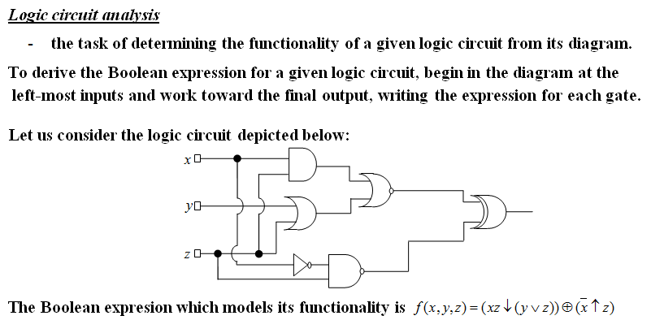
Example 2

Slide 9
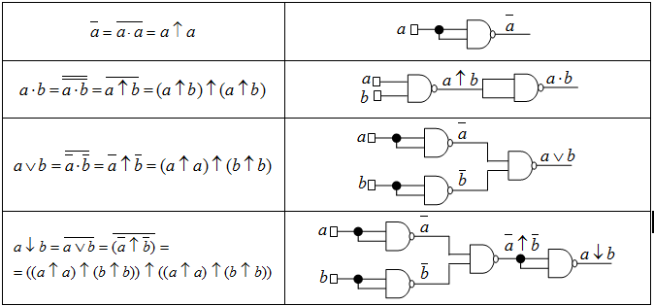
Example 3. NAND is a universal gate -it can be used to produce all the other gates

Slide 10
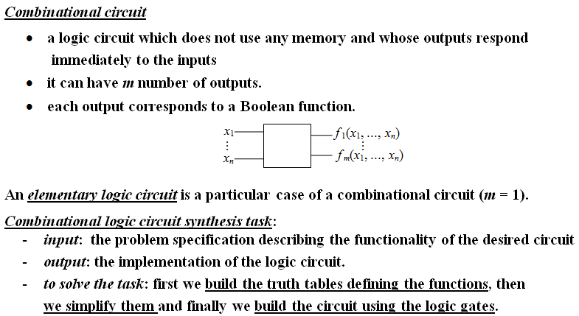
Combinational circuits

Slide 11
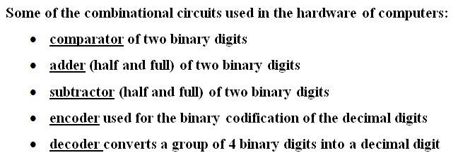
Examples of useful combinational circuits

Slide 12
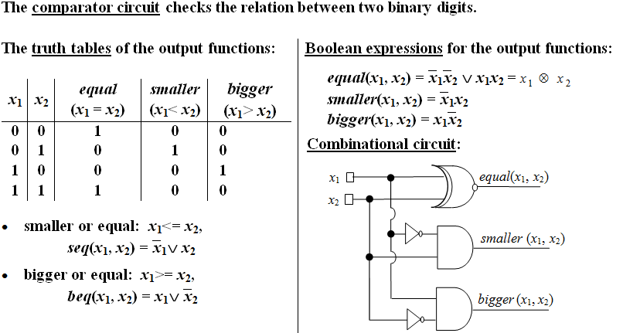
Example 4

Slide 13
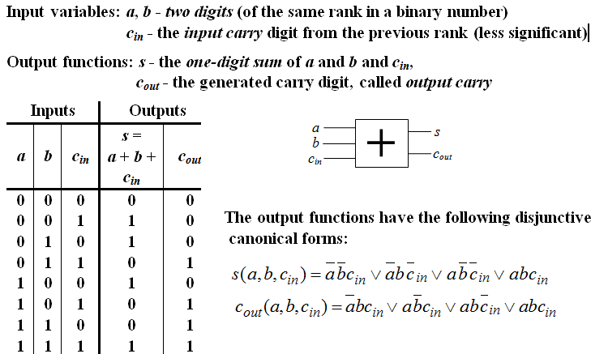
Example 5. Full Adder

Slide 14
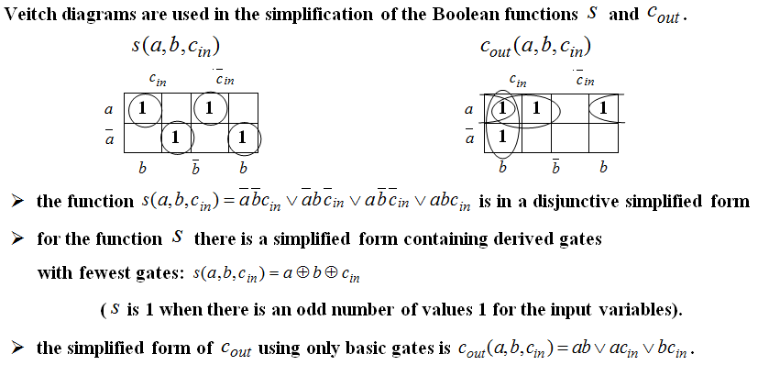
Example 5. Full Adder (contd.)

Slide 15
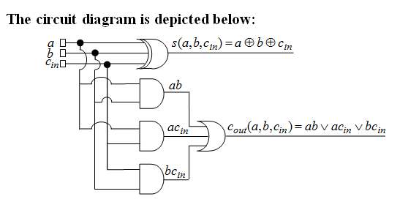
Example 5. Full Adder (contd.)

Slide 16
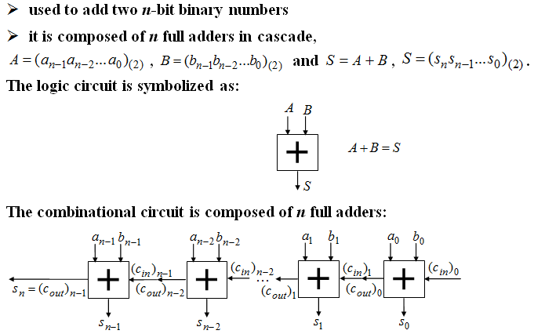
Example 6. n - bit parallel adder

Slide 17
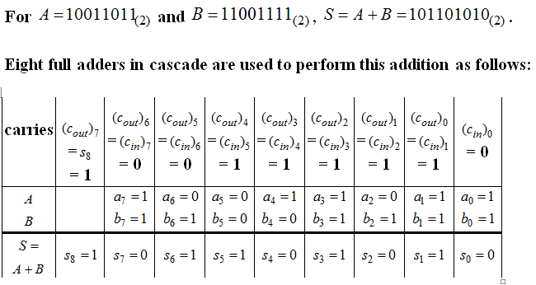
Example 6. n - bit parallel adder (contd.)

Slide 18
Fun with logic circuits
Domino computer:
https://www.youtube.com/watch?v=w6E7aQnA4Ws
Water computer:
https://www.youtube.com/watch?v=IxXaizglscw
Logic gates using Gears,Marbles & Dominoes
https://www.youtube.com/watch?v=kQeDnFUNW-Q

Slide 19
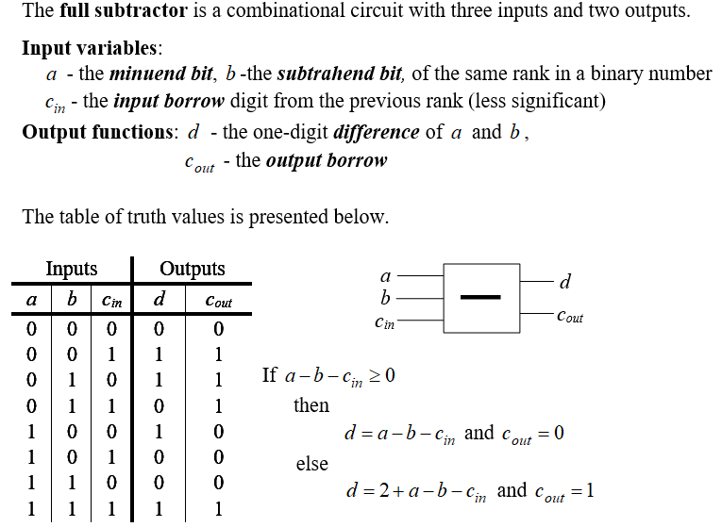
Example 7. Full Subtractor

Slide 20
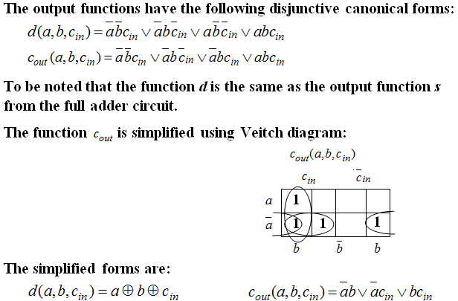
Example 7. Full Subtractor (contd.)

Slide 21
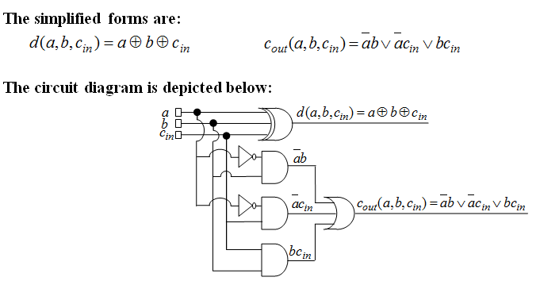
Example 7. Full Subtractor (contd.)

Slide 22
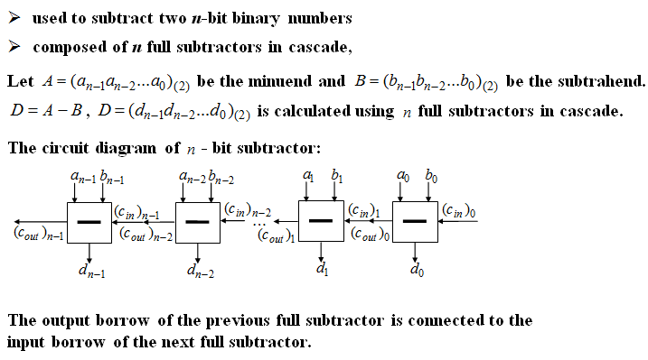
Example 8. n - bit parallel subtractor

Slide 23
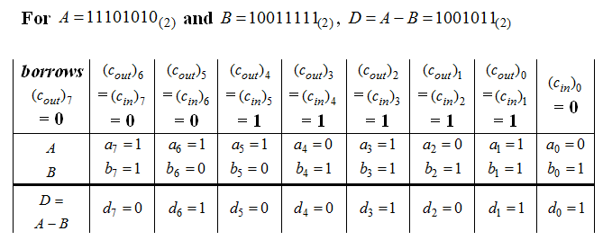
Example 8. n - bit parallel subtractor (contd.)

Slide 24
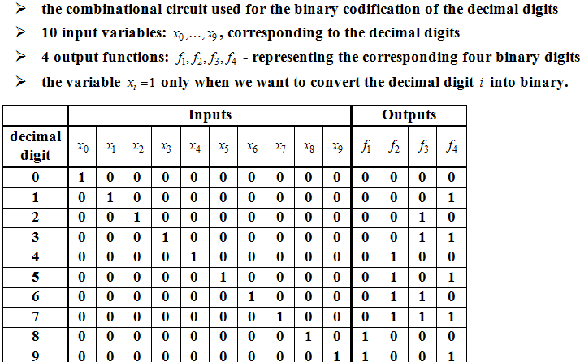
Example 9. Encoder

Slide 25
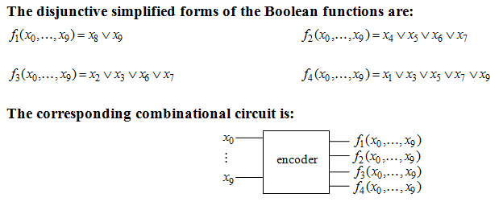
Example 9. Encoder (contd.)

Slide 26
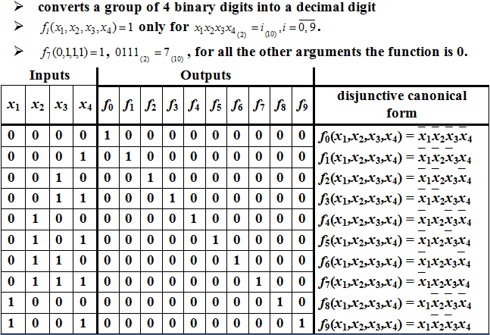
Example 10. Decoder

Slide 27
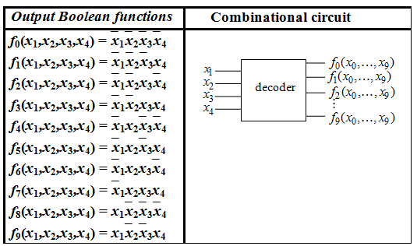
Example 10. Decoder (contd.)

Slide 28
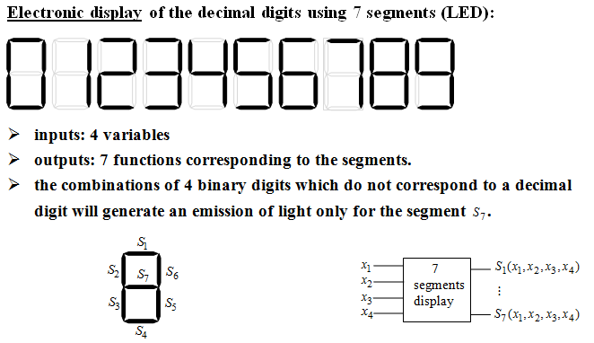
Example 11. 7 segments Circuit

Slide 29
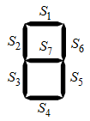
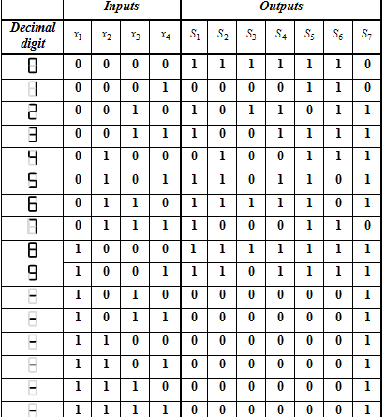
Example 11. 7 segments Circuit

Slide 30
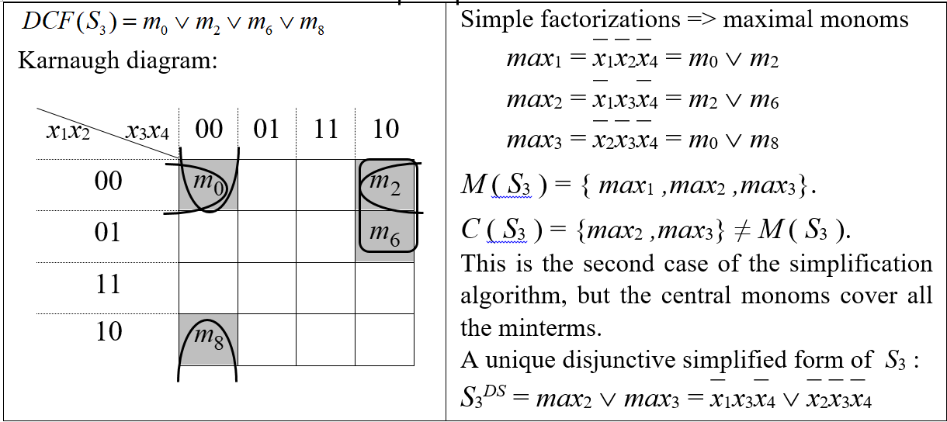
Example 12. Implement the Simplified Logic Circuit for S₃ using only NAND gates

Slide 31
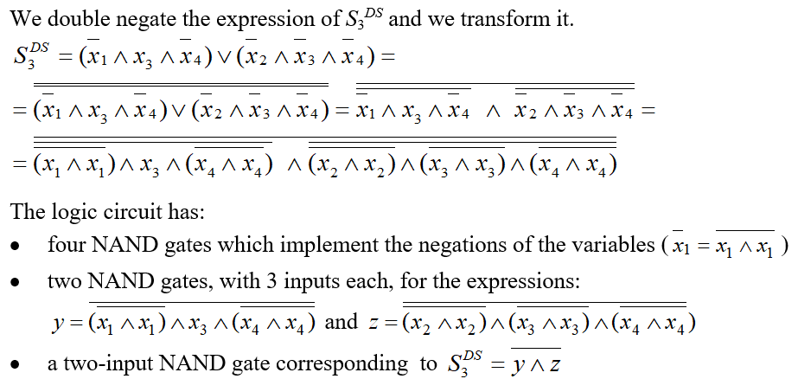
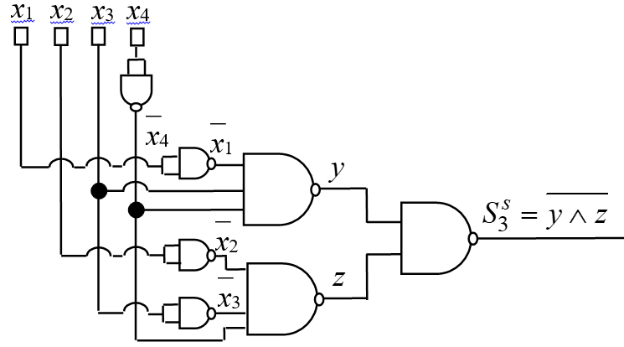
Example 12(contd.)

Slide 32
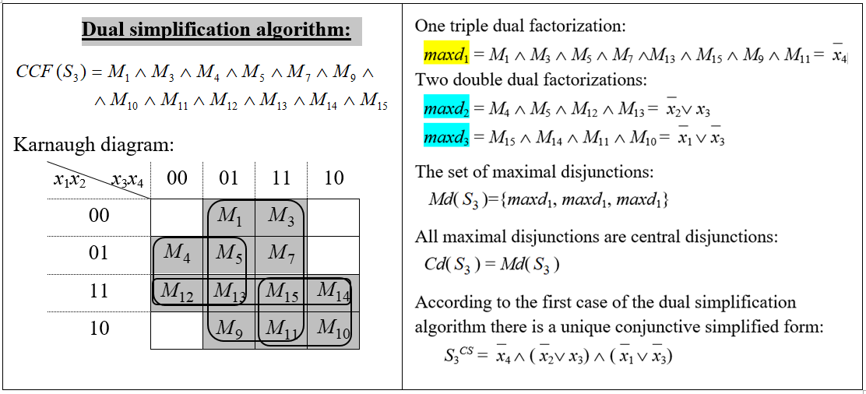
Example 13. Implement the Logic Circuit for S₃ using only NOR gates

Slide 33
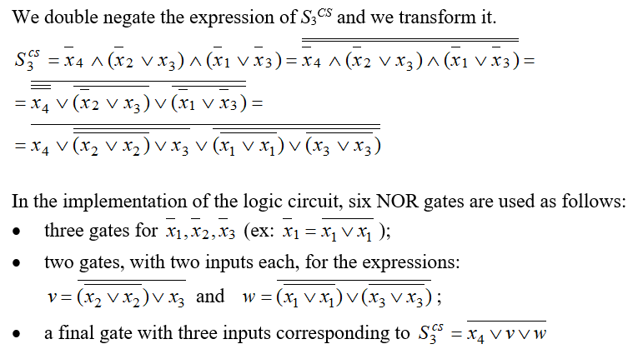
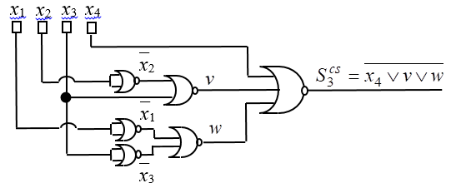
Example 13(contd.)

Slide 34
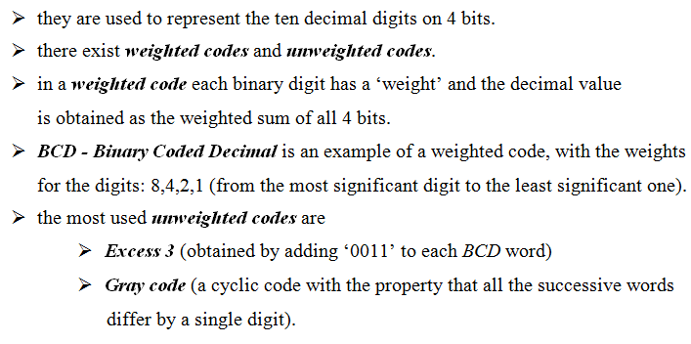
Binary codes

Slide 35
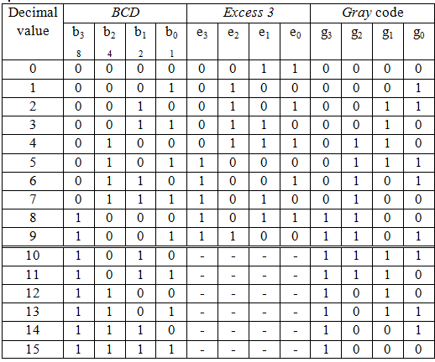
Binary codes (contd.)

Slide 36
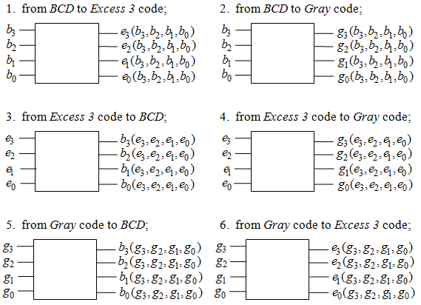
Example 14.

